Slide 1
CETSS Parents’ Evening April 2018
Agenda
Teas and coffees | Parents’ Council
Welcome | Colm
Greeting | Clair (Parents’ Council)
Curriculum & Innovation in CETSS | Colm
iPads and Schoology | David
School supports | Pam and Laura
Accommodation update | Colm
Q & A

Slide 2
Curriculum Reminder
Tasters in first term of First Year
8 subjects for Junior Cycle certification, plus 4 ‘Short Courses’
Continuous Assessment
iPads used to extend learning
Phenomenon-Based Learning Weeks
Student choice, where possible, to improve motivation

Slide 3
Subjects Reminder
Core Subjects | Optional Subjects | Short Courses | Other Learning Experiences
English | Art | *Digital Literacy | SPHE
Irish | Music | Ethical Education/ Philosophy | CSPE
Maths | Business | *Sustainability | Phenomenon-Based Learning
Science | Technical Graphics | PE
Spanish | Technology
History | Home Economics
Geography

Slide 4

Curriculum Innovation
‘CETSS is one of the top five innovative schools in Ireland’
Peter McGuire Journalist

Slide 5











Innovation- Links with external groups

Slide 6


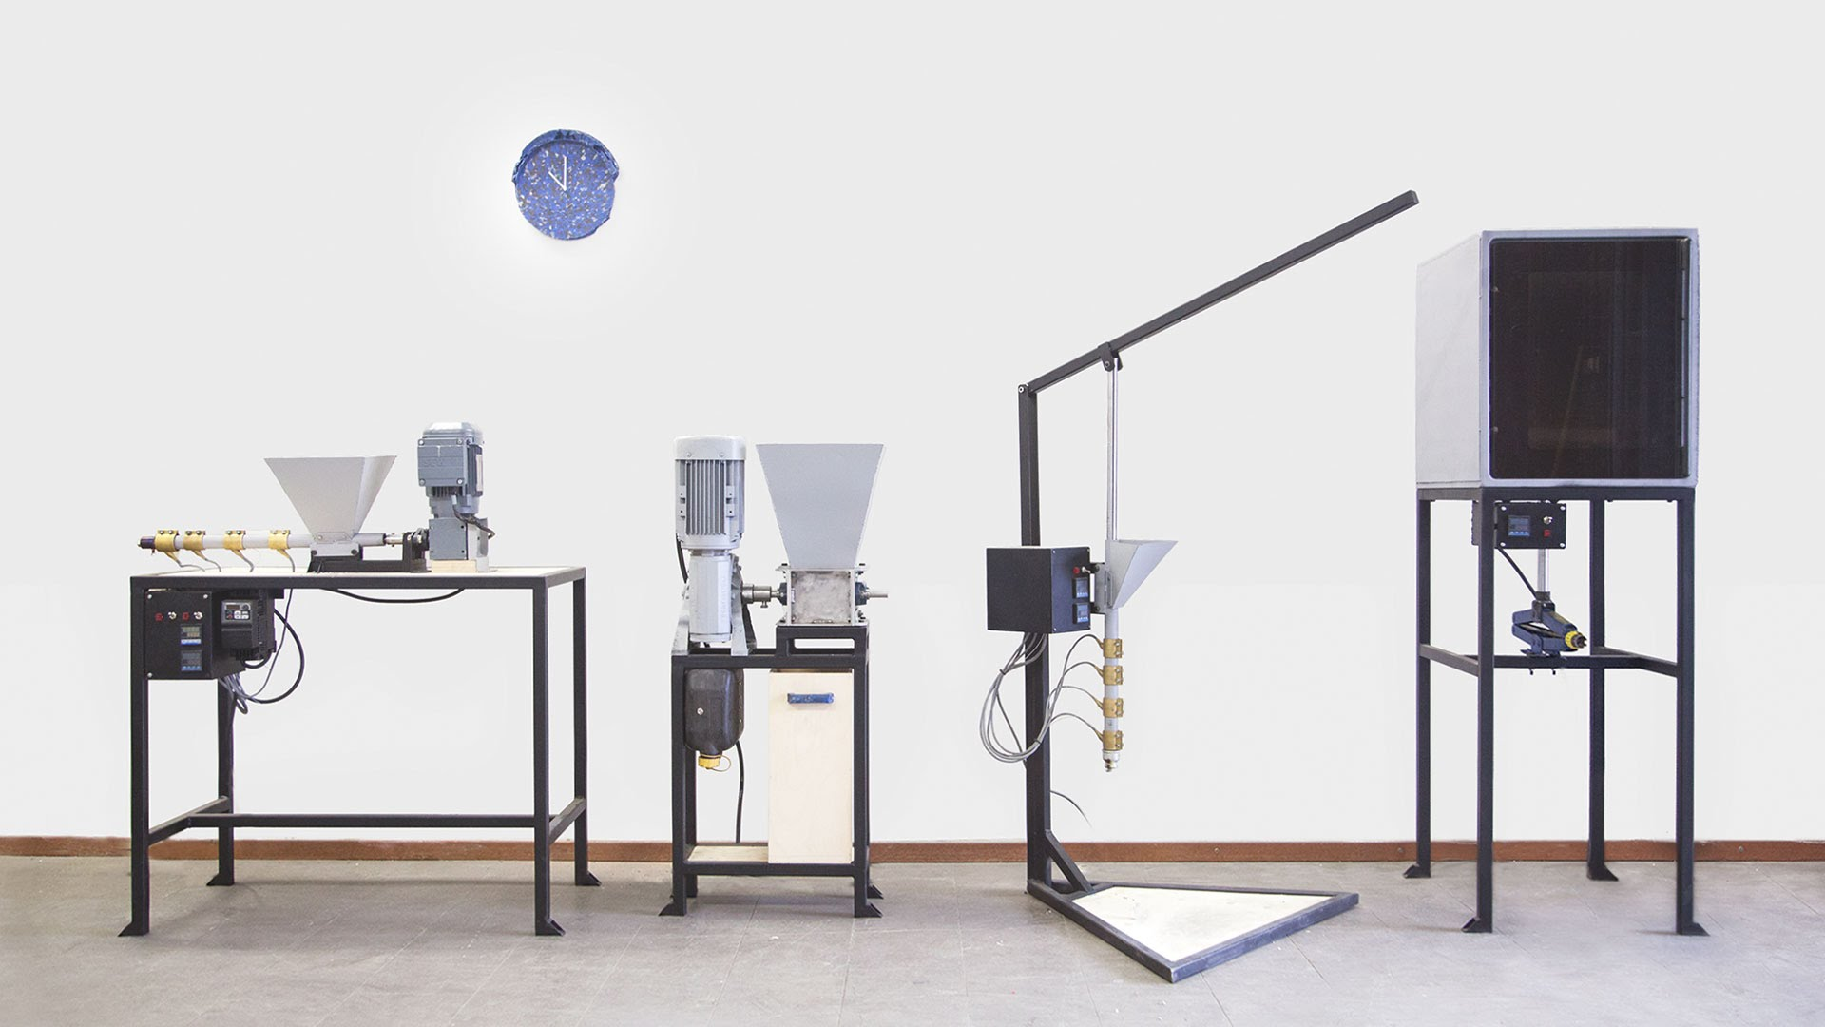
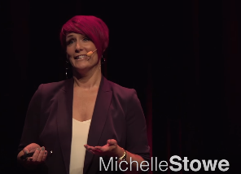


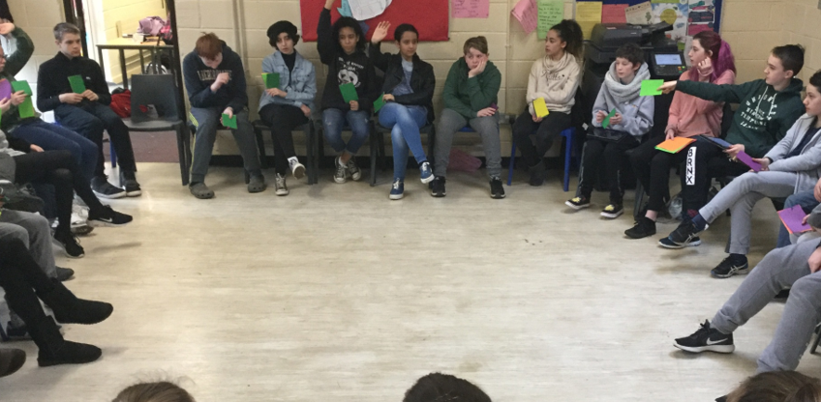

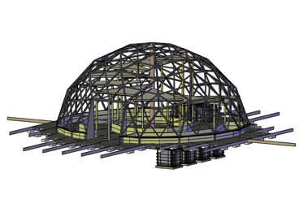
Innovation supported by Philanthropy

Slide 7


Guidance and Student Support
Cork Educate Together Secondary
Pam O’Leary
Guidance Counsellor and Teacher
Notes:
7

Slide 8

Aims for this session
  To help you to understand the role of SST
  To show you how we work with students (Ethical Ed)
  To explain how ‘Restorative Practice’ works
  To share information about the new Wellbeing Programme for the new Junior Cycle

Slide 9
Counselling and SST at CETSS
Being available to meet students individually and in groups to allow them to discuss issues which might impinge on their ability to learn/participate in school life
Devising appropriate student support strategies and interventions for students with SEN, EAL or counselling needs.
Promoting wellbeing in the school by organising initiatives such as talks, workshops and programmes e.g. wellbeing week, anti-bullying, LGBTQ awareness etc

Slide 10
Ethical Education (1st Year)
Ethical Education Curriculum
STRAND ONE
Values
Making Moral & Ethical Decisions/ Philosophy
Beliefs and Worldviews
Different Teachings & Perspectives
Diversity in Ireland
Migration
Power and participation
Gender equality
Development Education
STRAND TWO
STRAND THREE

Slide 11

Strand One: Values

Slide 12
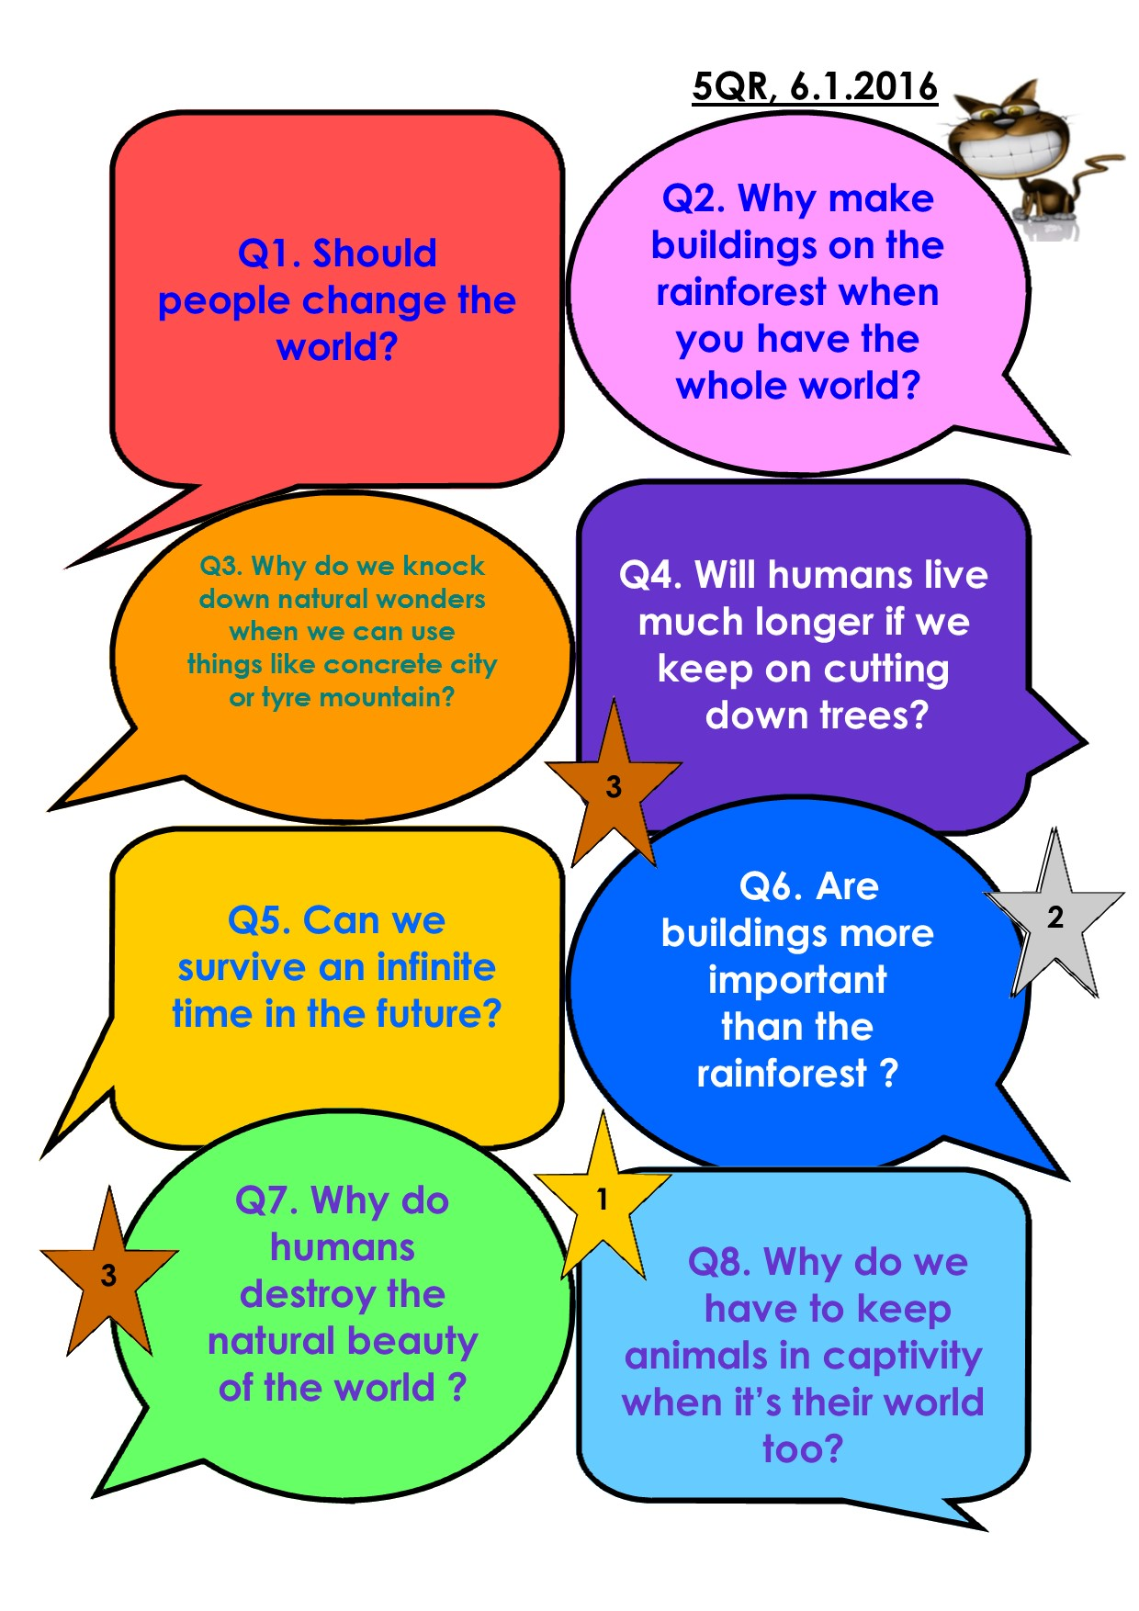
Philosophy and
Ethical Citizenship

Slide 13
How Restorative Practice works in our school
We aspire to use restorative language when we speak about our school and members of our community. (positive and without shaming)
We try to use one to one, small circle or larger circle RP interventions to resolve issues in the school.
We endeavour to use an approach to conflict that avoids shaming and blaming others.
We implement positive, proactive interventions to create a positive school culture (Picnics, student assembly, teambuilding, Learnsmart (group) or RP plus (individuals)
We use RP to inform our student support interventions and discipline procedures (agreed consequences, counselling, referrals, other supports)

Slide 14
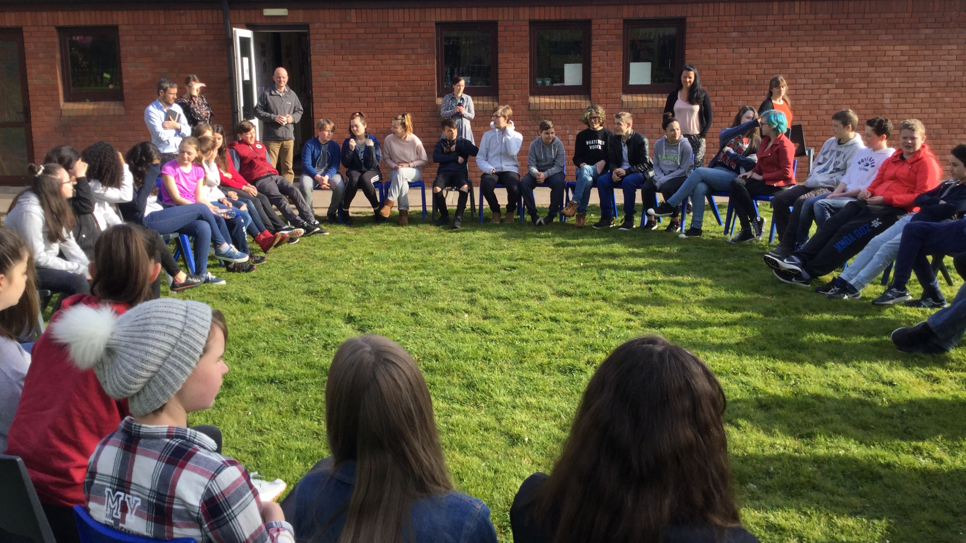

Slide 15
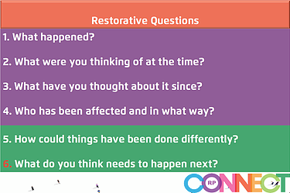

Slide 16
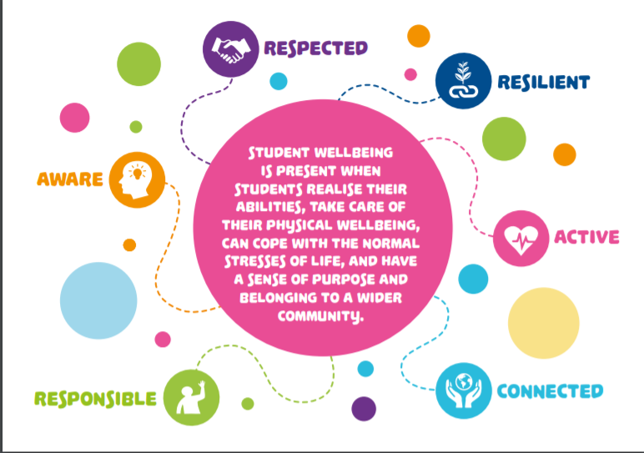
Wellbeing Indicators for Junior Cycle

Slide 17

Questions?

Slide 18

CETSS 21st Century Learning
Tablets (ipad)
&
ViRtual Learning Platform

Slide 19

Tablets (iPads)
Cost of package = iPads €354 or €439 & Services €99 (3yrs) & insurance recommended. Heavy duty case = €45
Online store open 25th May – 20th July (Code =95696779). NB Late fee!
Educational apps only, from the school-defined ‘whitelist’.
  BYOD ?
Used as a learning tool, not all-lesson-long!
  Access the VLP; Internet access;
  Store teacher-developed resources & iBooks;
  Coding; Educational Apps (Duolingo, Garageband, Build-Up…);
  Take notes; Share documents; Photo, sound & video recording; Facilitate groupwork;

Slide 20
Schoology introduction
Courses set up by teachers; students join.
  Accessed in school (Ipads) or at home (any device) or anywhere online!
Teachers provide resources, assignments, updates, quizzes, video, blogs, forums…
Learning can be targeted or individualised => differentiation.
Assessment can be tailored to specific needs.
Student-teacher AND student-student communication & collaboration.
Teacher-teacher communication and collaboration (departmental & system-level).

Slide 21
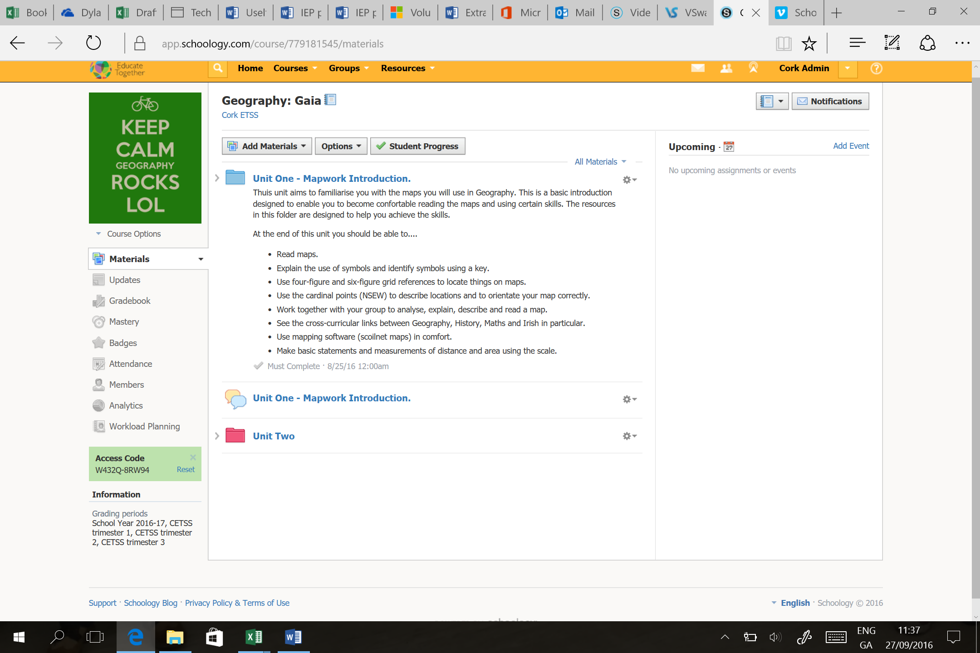
What it looks like
Student content & Activities.
Communication.
5 School collaboration!
Progress.

Slide 22


Slide 23

Class Tutor
Pastoral role
Educational matters.
Restorative Practice
House keeping
Journal-Communication
Links with:
  Social Personal Health Education Programme (SPHE)
  Student Support Team
  Whole Staff
  Deputy Principal
  Principal

Slide 24

Student Support Team
Collaboration between Guidance Counsellor and Special Educational Needs (SEN) Coordinator
Weekly review of student needs in relation to well being.
Holistic Supports and interventions implemented
Informal Check in’s with students well being.
Student Support Team Feed into the whole school plans.

Slide 25

Bounce Back Programme
Tools for Building Resilience
Enhancing coping skills for dealing with life's challenges and following positive goals.
Becoming the boss of our feelings
Building inner strength and self esteem
Developing our own relaxation programme.
Using thought challengers to manage negative thoughts
Applying the traffic lights analogy to daily challenges.

Slide 26
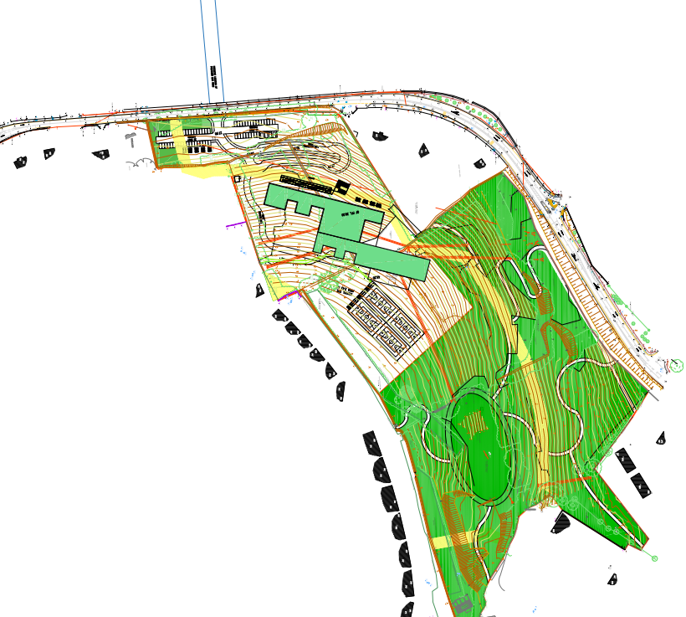
Accommodation Update: Permanent Site
Douglas Village
Est. delivery date: 2019-20 school year
Planning App imminent
‘Rapid Build’ Programme
Conveyancing complete

Slide 27
Accommodation update- Temporary site
Possible locations:
Nagle Community College
Nemo Rangers GAA Club
Other
Needs:
Appropriate work space
Room to grow
Technical rooms
Access- transport

Slide 28
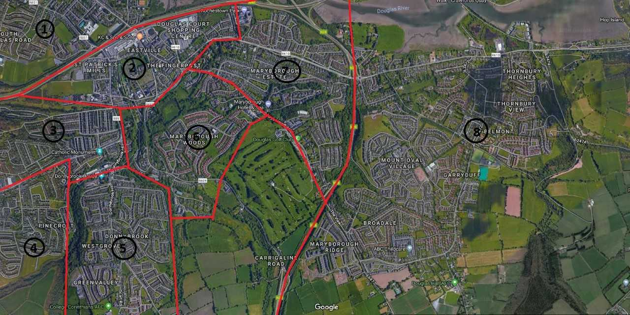
Transport
Planning
Contingency Planning:
Bus routes
School bus(es)
Private transport
Car-pooling

Slide 29
Timeline
April - DES decide location & Zip-lining
May - Dedicated transport meeting, if necessary
May/June- iPad purchasing- Wriggle
& Summer picnics

