Slide 1
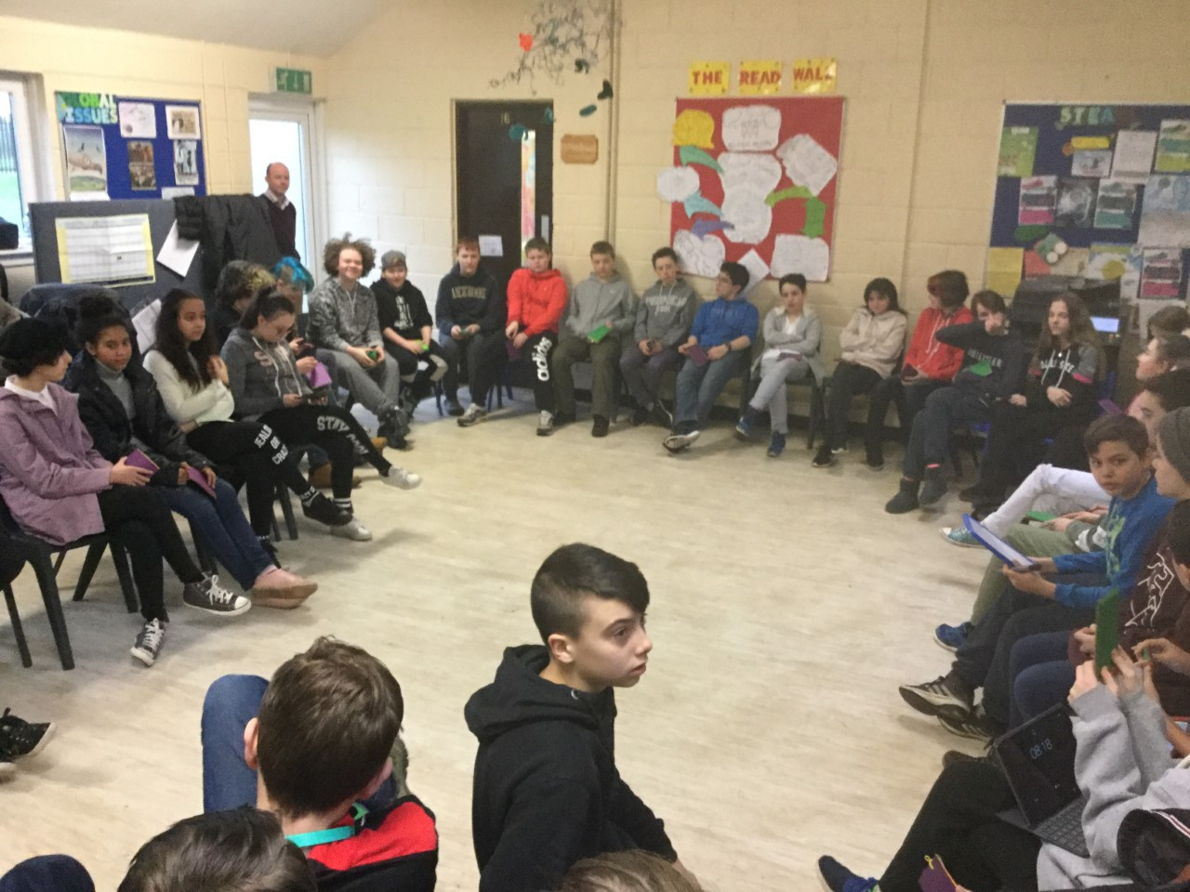
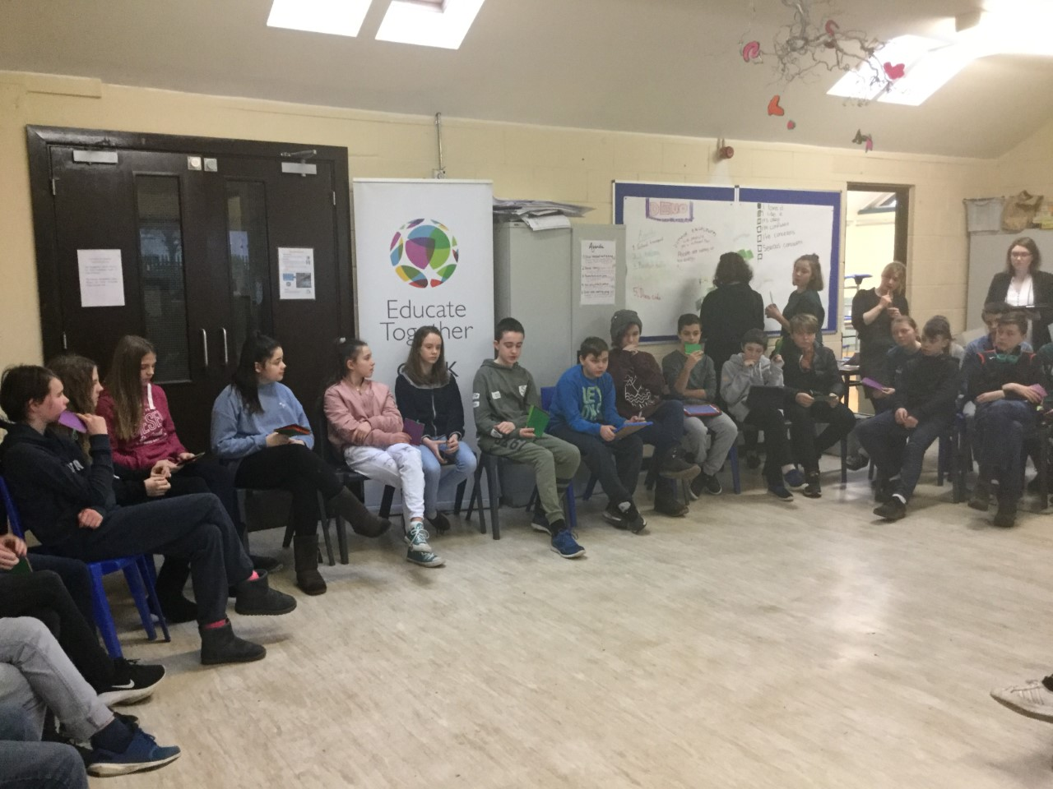
How can we develop democratic policy and decision making at CETSS?
How policies could be agreed democratically in our school
Overview of a draft Democracy Policy under development – feedback welcome
Parental involvement more broadly (ideas from teachers and management about current opportunities for collaboration)

Slide 2
Decision making bodies within our school community
Student Assembly
Teaching
staff
Parents Council
Management Principal and Deputy Principal(s)
Board of Management
Other partners:
Department of Education
Educate Together

Slide 3
How these partners currently make decisions…
Student Assembly
Meets monthly, decides by consensus of all students present
Teaching staff
Meets (weekly at present) decides by consensus of all teaching staff
Meets monthly, decides by majority vote of those in attendance
Parents Council
Meets monthly, decides by consensus of all members, but can take a vote where consensus not reached.
Legally Principal is responsible for decisions, in practice made by consensus
Management Principal and Deputy Principal(s)
Board of Management
Other partners:
Department of Education
Educate Together

Slide 4
The next three slides give some hypothetical examples of how policies could created and adopted by these five partners.

Slide 5
Example 1: Anti-Bullying Policy (example assumes no changes are proposed to initial draft)
Student Assembly can ratify the draft after 1 month for discussion
A draft policy is developed by teacher volunteer(s)
group
Teaching staff meeting ratifies draft after 2 weeks given for reading / comment
Parents Council can ratify draft after 1 month for discussion
Principal checks for consistency with ethos, legal and Department of Ed constraints and passes on the proposal
Board of Management adopts interim policies recommended by the Principal to allow for functioning of the school while mutually agreed policies are being developed.
Board of Management discusses and adopts the policy

Slide 6
Example 2: Dress Code
A draft dress code is developed by student working
group
Student Assembly ratify the draft after 1 month for discussion
Teaching staff meeting proposes 1 amendment after 2 weeks given for discussion
Parents Council propose 1 amendment after 1 month for discussion
Principal checks for consistency with ethos, legal and Department of Ed constraints and passes on the proposal
Board of Management discusses and adopts the policy
Board of Management adopts interim policies recommended by the Principal to allow for functioning of the school during this process of reaching mutual agreed policies.

Slide 7
Example 3: Wellbeing Policy
A draft Wellbeing policy is developed a parent
working group in collaboration with Wellbeing teachers
Student Assembly ratify the draft after 1 month for discussion
Parents Council agree on the proposal with amendments after 1 month for discussion
Teaching staff meeting ratify the draft after 2 weeks given for discussion
Principal checks for consistency with ethos, legal and department constraints and passes on
Board of Management adopts the policy
Board of Management adopts interim policies recommended by the Principal to allow for functioning of the school during this process of reaching mutual agreed policies.

Slide 8
Note:
These examples given assume very little disagreement between the partners. Where there is more work to be done in reaching agreement there would be further round of the same process.
The need for such further rounds might be reduced by good communication between parents and teachers and students during development of the initial policy draft.

Slide 9
How should information be communicated between decision making bodies?
Under the system outlined here the Principal takes responsibility for this communication but could be supported by publication of minutes / agreed reports of non-confidential decisions from meetings of:
The Parents Council
Student Assembly
Staff Meeting
Management meeting
Board of Management
..on a parent section of the school website and on the Staffroom and Student Assembly schoology pages.

Slide 10
Policy drafts that are currently being developed by staff and are at an advanced stage (soon to be passed on to Teacher, Student and Parent bodies)
What stage are key policies at right now?
Policy drafts currently with teaching staff for discussion
Dignity in the Workplace
Sexual Harassment Policy
Policy drafts that have been agreed by the Teaching Staff and now need ratification by Student and Parent bodies
Anti-Bullying Policy
School Trips Policy
Critical Incident Policy
Assessment Policy (ready to send)
Health and Safety Policy (draft nearing completion)
Code of Behaviour (draft nearing completion)
Homework Policy (draft nearing completion)
Democracy policy (under development)
Policy drafts that are currently being developed students
Dress Code

Slide 11
Examples of policies that have been adopted by the Board of the Management
Admissions
Child protection
Dress Code
School Attendance
ICT Acceptable Use
SEN
RSE
Substance abuse and misuse
Garda vetting
Protected disclosure policy
Staff Grievance
Grievance and disciplinary procedures for non teaching staff
Disciplinary procedures for teachers and the principal
Complaints procedure

Slide 12
Should all partners have an equal say in all decisions?
CETSS Democracy Policy could set out principles to navigate this area.
The following slides (13-23) give an impression of principles under consideration for inclusion in the first draft of this policy. These are in draft form only and should not be read as a policy ready for review.

Slide 13
Overview of a draft Democracy Policy
DRAFT ONLY

Slide 14
Rationale
DRAFT ONLY
Democracy is a cornerstone of CETSS. Many students joining CETSS will have been involved in authentic decision-making within student councils, unions, committees or working groups in their primary schools. CETSS aims to bring student participation democratic processes beyond this basic level of participation to “a more sophisticated level of participation” where “students will share their voice by collaborating in decision-making with teachers and adults to improve educational outcomes.” (Educate Together, 2009). As a community, we embrace this challenge. We commit to developing truly inspirational, empowering democratic structures that will equip all young people in our community with skills for active participation not only in school democracy, but in the creation of a more equal and democratic society.

Slide 15
Guiding principles Our democratic processes and their outcomes will be consistent with the values and ethos of the school and guided by the following principles:
DRAFT ONLY
Decision making at CETSS is;
Authentic
Participatory
Supported by all
Meaningful
Decentralised / non-hierarchical
A source of autonomy and creativity
Consensus-based
Transparent

Slide 16
DRAFT ONLY
1. Authentic
Students must genuinely have decision-making power. Tokenism or manipulation are unacceptable. The Student Assembly will have a fair and appropriate share of decision-making power, balanced by the decision-making power of the other four decision-making bodies of the school. Student democracy will never be just for show.

Slide 17
DRAFT ONLY
2. Participatory
Within the student body, power belongs to all students, not just a chosen, elected or self-selecting few. All CETSS students will have the chance learn the skills they need for lifelong democratic engagement. Far beyond marking a tick on a ballot paper, students need to be able to self-organise, analyse complex problems, listen to and integrate conflicting perspectives, find compromises and propose solutions. To develop these democratic competencies CETSS will support all students to engage in participatory democracy rather than merely electing a student council once per year to make decisions on their behalf. While the Parent Council, Teachers and Management will select their own decision making procedures, all partners seek to include and support all those within their respective groups to participate fully in decision making.

Slide 18
3. Supported by all
The school’s processes of participatory democracy (e.g. Student Assembly) are a core part of school life. These processes will be given dedicated support, timetabled time and resources appropriate to the significance of democracy as a cornerstone of our school. Student Assemblies will not be optional add-ons afterschool and ideally not be squeezed into classtimes or lunchtimes. Management, teachers and parents will support and expect all students to participate fully in the democratic processes of the school.
DRAFT ONLY

Slide 19
DRAFT ONLY
4. Meaningful
Schools make big decisions that affect young people’s lives. Students have a right to participate in these meaningful decisions that significantly affect their lives. Being involved in issues such as uniform, food, litter, fund-raising and extracurricular activities is not enough. Students should be involved in, for example, in making decisions about what and how they learn and how their learning is assessed; curricular planning; co-creating new school designs; working groups on school improvement and contributing to the appointment process for positions in the school and development of core school policies.

Slide 20
DRAFT ONLY
5. Decentralised / non-hierarchical
The management of CETSS (The Principal and Deputy Principals) act as guardians of the school ethos and are responsible for sustainable and progressive the development of the school as a system, rather than as sole decision makers.
Power is shared between five bodies (Student Assembly, Parent Council, Staff, Management and BOM). Decisions will be taken by the broadest possible number of people. Ideally all persons affected by a decision should have a say in the decision. The degree of decision making power of any one decision making body should reflect the relative degree to which they are affected by the decision. For this reason and where policies are heavily prescribed by the state some policies will not require ratification by all decision-making bodies.
Situations where small sub-groups of people take decisions which significantly affect the lives of students without their input are to be avoided as far as possible. The Board of Management can exclude Management, Student Assembly, Parents Council or teaching staff from taking part in making a decision where there is justifiable reason (e.g. student wellbeing, health and safety requirements, legal requirements, confidentiality). Any decision-making body can appeal an exclusion from a decision.

Slide 21
DRAFT ONLY
6. A source of autonomy and creativity
Students are encouraged to take initiative, make creative new proposals, set up working groups, generate ideas and get approval from the relevant decision making groups (e.g. student assembly, parent council, staff meeting, BOM) and act collaboratively to implement their ideas and solutions. Similarly teachers and parents are encouraged to develop proposals, collaborations and activities that contribute to the achievement of the mission of the school.

Slide 22
DRAFT ONLY
7. Consensus-based
Our practices will strive include everyone’s voice regardless of age, race, ethnic background, gender, class, sexuality or ability. Minority perspectives will not be silenced by majority votes. Consensus decision making will be used as far as practically possible. Consensus decision-making is about trying to find common ground and solutions that are acceptable to all. This attempts to ensure that everyone’s opinions, ideas and concerns are taken into account.
In practice, the Student Assembly may decide by consensus to grant autonomy to a working group to use an alternative decision making process (e.g. a secret ballot of students, an online poll or survey) if this is agreed to be the most suitable method for the decision concerned. The Student Assembly can decide to amend its decision making procedures.
All decision making bodies (Student Assembly, Management, Staff, Parent’s Council) should agree upon and publish their own internal decision making procedures.

Slide 23
Appendix – Decisions List (EXAMPLES FOR ILLUSTRATIVE PURPOSES ONLY)
Area of decision making (with specific example) | Student Assembly…. | School management meeting… (Principal and deputy principal) | Staff meeting… | Parent council… | Board of Management…
Anti-Bullying Policy | Can make proposals Must ratify proposal | Can make proposals Must ratify proposal | Can make proposals Must ratify proposal | Can make proposals Must ratify proposal | Can make proposals Must ratify final policy.
Child Protection Policy | Can make proposals | Can make proposals Must ratify proposal | Can make proposals | Can make proposals | Can make proposals Must ratify final policy.
Dignity in the Workplace policy | Can make proposals | Can make proposals | Can make proposals Must ratify proposal | Can make proposals | Can make proposals Must ratify final proposal
DRAFT ONLY

Slide 24
3. Parental participation more broadly: The Blueprint
‘Parental participation in Educate Together schools goes beyond parental involvement on Boards of Management and Parent Associations and at second-level Educate Together will continue to pioneer this partnership approach in Ireland.
Through the development of its democratic principle, ‘to enable the highest level of participation and partnership’ (Educate Together Charter 1990) Educate Together second-level schools will continue to involve parents in the educational process and extend the educational opportunities available to learners, while positively affirming the professional role of the teacher (Educate Together Charter 1990).’
Notes:
https://www.educatetogether.ie/sites/default/files/blueprint-final.pdf

Slide 25
Blueprint
‘Multiple opportunities for participation will be developed, from participation on boards of management, parent associations and school committees, to involvement in everyday school activities such as:
participating in classroom activities;
organising and facilitating extra-curricular activities;
supporting activities such as paired reading and paired maths;
developing and/or assisting with artistic, musical, dramatic, linguistic, or scientific and technological programmes;
supporting the delivery of Educate Together’s distinct ethical curriculum’
Notes:
https://www.educatetogether.ie/sites/default/files/blueprint-final.pdf

Slide 26
Immediate partnership opportunities identified by teachers…
Supporting / leading extra-curricular activities - encouraging students to join clubs, helping to run clubs
Donating / sourcing materials / equipment / funding for clubs, school library, garden and bike workshop…
Creating working groups to support particular subject departments (Art, Humanities, Science, Computing…)
Running workshops / education sessions for parents (e.g. on ICT use, Homework, E-safety, social media and young people, summer learning opportunities…)
Developing proposals for future Phenomenon Based Learning Weeks (could be an opportunity for collaboration between parent and student?)
Making proposals for teaching and learning activities including field trips, celebrations, experiments, challenges, homework activities…(Science Week 2017?)
Notes:
http://www.sfi.ie/assets/media/files/downloads/Funding/Funding%20Calls/Discover%20Programme/2017/Science%20Foundation%20Ireland%20Science%20Week%20Call%202017.pdf

Slide 27
Other partnership opportunities
A working group(s) to support the development of the new temporary accommodation and final school site / buildings - parents (or other voluntary contacts) with experience in the following areas: engineering, architecture, planning applications, construction etc. If you have any experience in this area, and are willing to help brainstorm some ideas, please Colm know.
Practical assistance with the move to new site (moving teaching supplies, furniture ) when the time comes?
Afterschool homework club run by parents? (3:30pm -4.45pm) Garda Vetting would be required.
Notes:
http://www.sfi.ie/assets/media/files/downloads/Funding/Funding%20Calls/Discover%20Programme/2017/Science%20Foundation%20Ireland%20Science%20Week%20Call%202017.pdf

Slide 28
Extra-curricular clubs parents could support or add to…
Mondays 8.00 - 8.30am - Global Issues Café – a free subscription to a newspaper or journal would be a great if anyone has contacts?
Tuesdays 3.30-4.30pm – Drama – volunteer drama facilitators welcome. Suggestions for plays / sourcing scripts materials and further items later in the year. Minimum 6 students needed to keep this going so parental encouragement to join/stay involved would help…
Wednesdays 12.45 – 1.45pm – Creativity Club
12.45 – 1.45pm Athletics: Coaching of Track and Field events from February-June. Have you experience in events such as shot-putt, discuss, javelin, long-jump, high-jump, hurdles, pole-vault, sprint-events, distance-running. Garda vetting would be required.
1-2pm Woodwork: Experienced woodworkers would be very welcome to co-facilitate this and develop new projects (currently we aim to build a sit and reach box for a science experiment and a bookshelf on wheels)
Friday 3.30-4.30pm – STEAM – mentors / experts to speak to students about their science project plans e.g. experts on sound, water quality and sports sciences would be helpful at the moment

Slide 29
Other areas for greater communication and collaboration:
Teachers would welcome contact from parents about learning issues – notes in journals or call the office, set up meetings with subject teachers or class tutors where possible
New extra-curricular clubs? Debate team coaching has been offered..
Establishing the school library

Slide 30
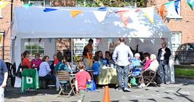
Whole school community events parents could help to organise…
Music gig (being organized by students) but could be an opportunity for parents too…providing equipment / transport / logistics…
Local food feast in May (being organized by students) but existing and new parents to be asked to start growing food for it and to come along… parents could volunteer as musicians, provide activities for younger children…
Art exhibition - collaboration with Sample Studios
School-warming party in September?

Slide 31
Examples of events/ activities parents could co-organise with teachers and/or students
Student trips / exchanges for coming year?
Engineers Week (March 2017 –STEAM parents)
World Book Day (March 2017)
International Women’s Day (8th March)
Tree Week (March 2017)
Science week (Nov 2017)
CSO/John Hooper Medal for Statistics (Feb)
SciFest (entries by 10th March)
Young Scientist (entries by end Sept 2017)
CSO Open Data Award (at BTYSE)
Apps for Gaps

Slide 32
Long term collaboration group between teachers and parents?
STEAM group – already established
Humanities group?
Sustainability / Environment group?
Wellbeing / mental health group?
School building support (engineering, architecture, planning applications, construction)

Slide 33
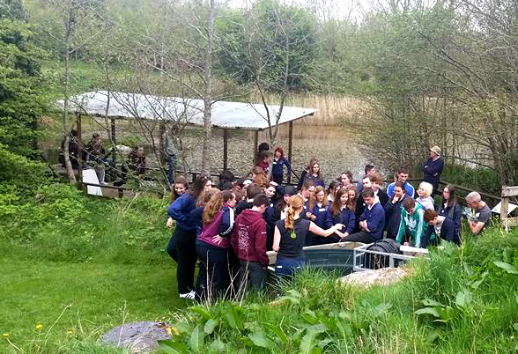
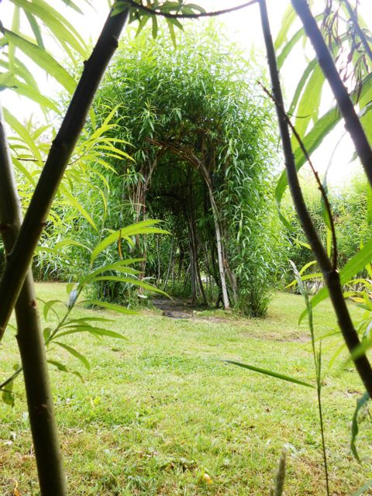
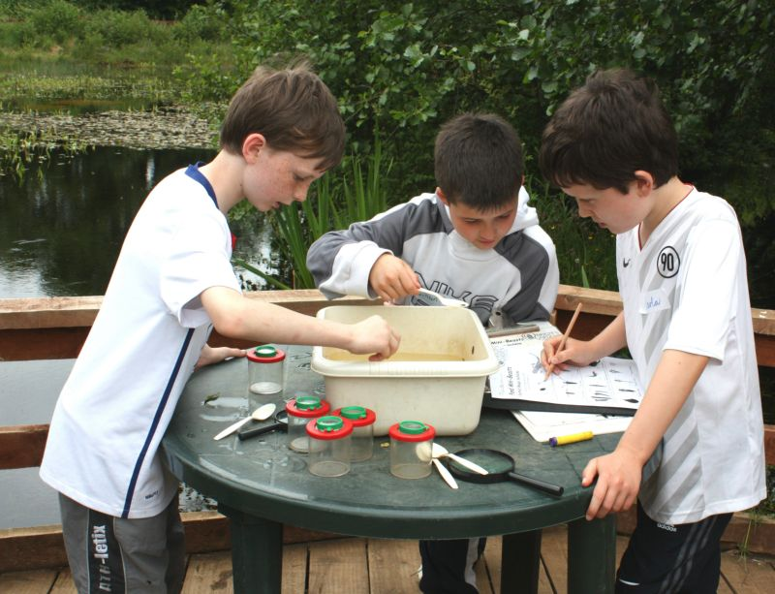
An example of an idea for long term collaboration: STEAM for Society and Sustainability A 21st century education centre on grounds of our new site
Idea: Collaboration to develop a self-sustaining centre of excellence for STEAM and sustainability education, located on the grounds of a new ET secondary school
Allow students to experiment with solar, hydro and wind technologies in school, collect data (short and long term projects), design and build technologies. Students could also facilitate workshops for younger children.
Should we create a sustainability group for teachers and parents who are interested in this? / or existing STEAM group would look into SFI, LA21 and SEAI grants to create an outdoor learning environment for STEAM. e.g. SFI Discover funding for renewable energy technology garden?
Inspiration in terms of outdoor learning spaces: Brigit’s Garden in Galway, Carrig Dulra in Wicklow, Sonairte near Dublin…but with more STEAM activities and wider range of STEM partners (including CSO)…

Slide 34
STEAM for Sustainability /STEAM for Society:
We could apply for funding for a programme or series of programmes that would promote and support STEAM education at a new hub in Cork. We would develop and pilot the educational programmes with our own students in order to develop self-financing programmes for 6th class primary, junior cycle and Transition Year (TY) students open to all schools in the region. We could provide a space for innovative activities using renewable energy technologies that give students hands on experience using STEAM approaches to solve real world problems in the fields of energy, climate change, biodiversity and sustainable agriculture.
The programme could create a unique centre for STEAM and sustainability education in Cork where:
- STEAM activities could take place in stunning outdoor living classrooms
Primary pupils could experience STEAM activities geared towards sustainability in outdoor setting
Teachers can access sustainability and STEAM CPD
Secondary students can attend workshops and activities that have been developed with secondary school students
Schools can get professional advice and support on running STEAM and Sustainability education programmes
A design lab could link computer science and sustainability, including 3D printing facilities
new science-linked development education programmes could be piloted (e.g. partnership with Mind the Gap and other local dev ed arts groups)

